Slide 1

PowerPoint…

Slide 2
It gets a lot of stick

Slide 3
“PowerPoint makes us stupid.”
General James N. Mattis,
US Secretary of Defence

Slide 4
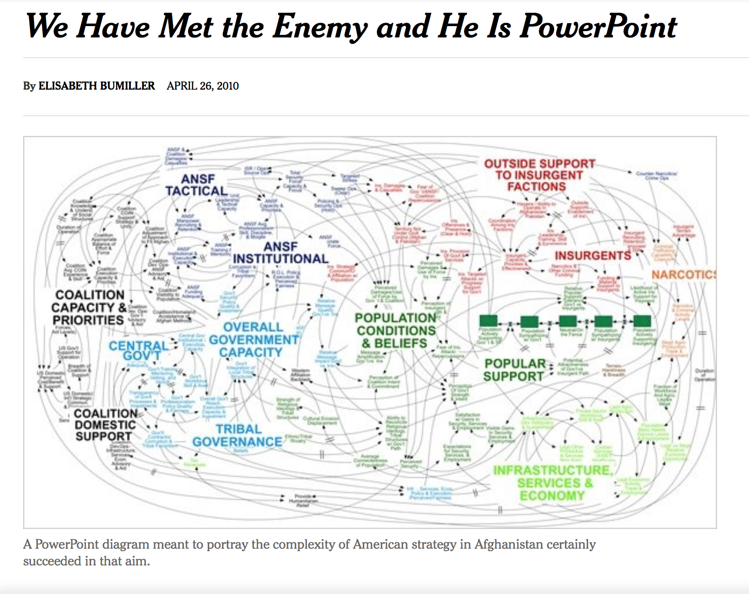

Slide 5
“When we understand that slide, we’ll have won the war”
General Stanley McChrystal,
(then) Head of US Forces in Afghanistan

Slide 6
PowerPoint even has its own political party

Slide 7


Slide 8
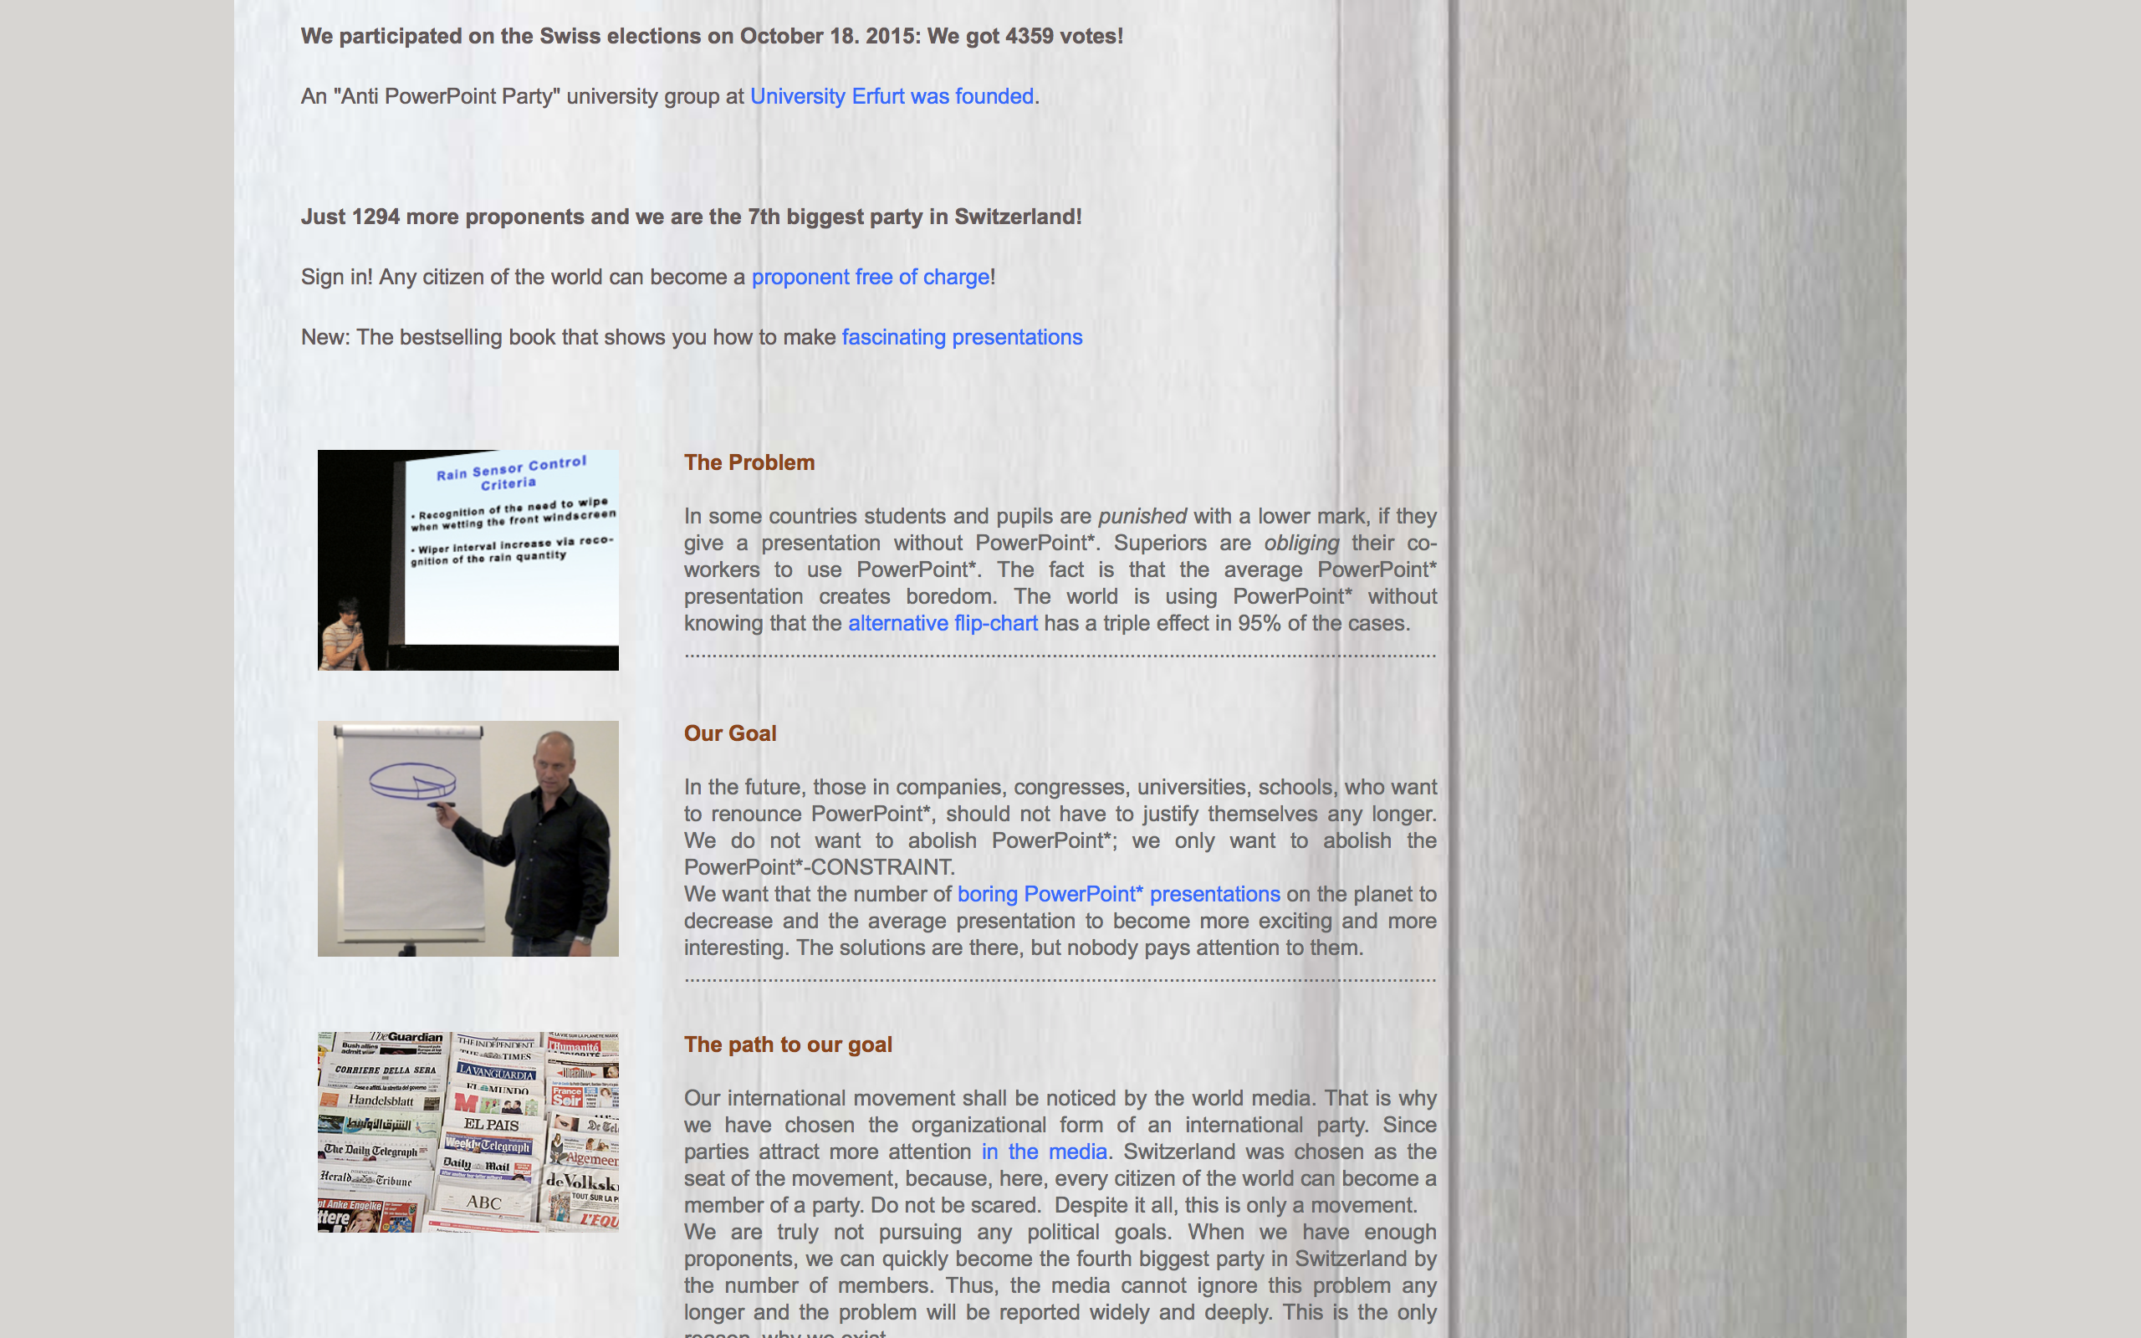

Slide 10
Creating PowerPoint files with Officegen and Node.js
Paul Jensen

Slide 11
PowerPoint is very popular for making diagrams

Slide 12
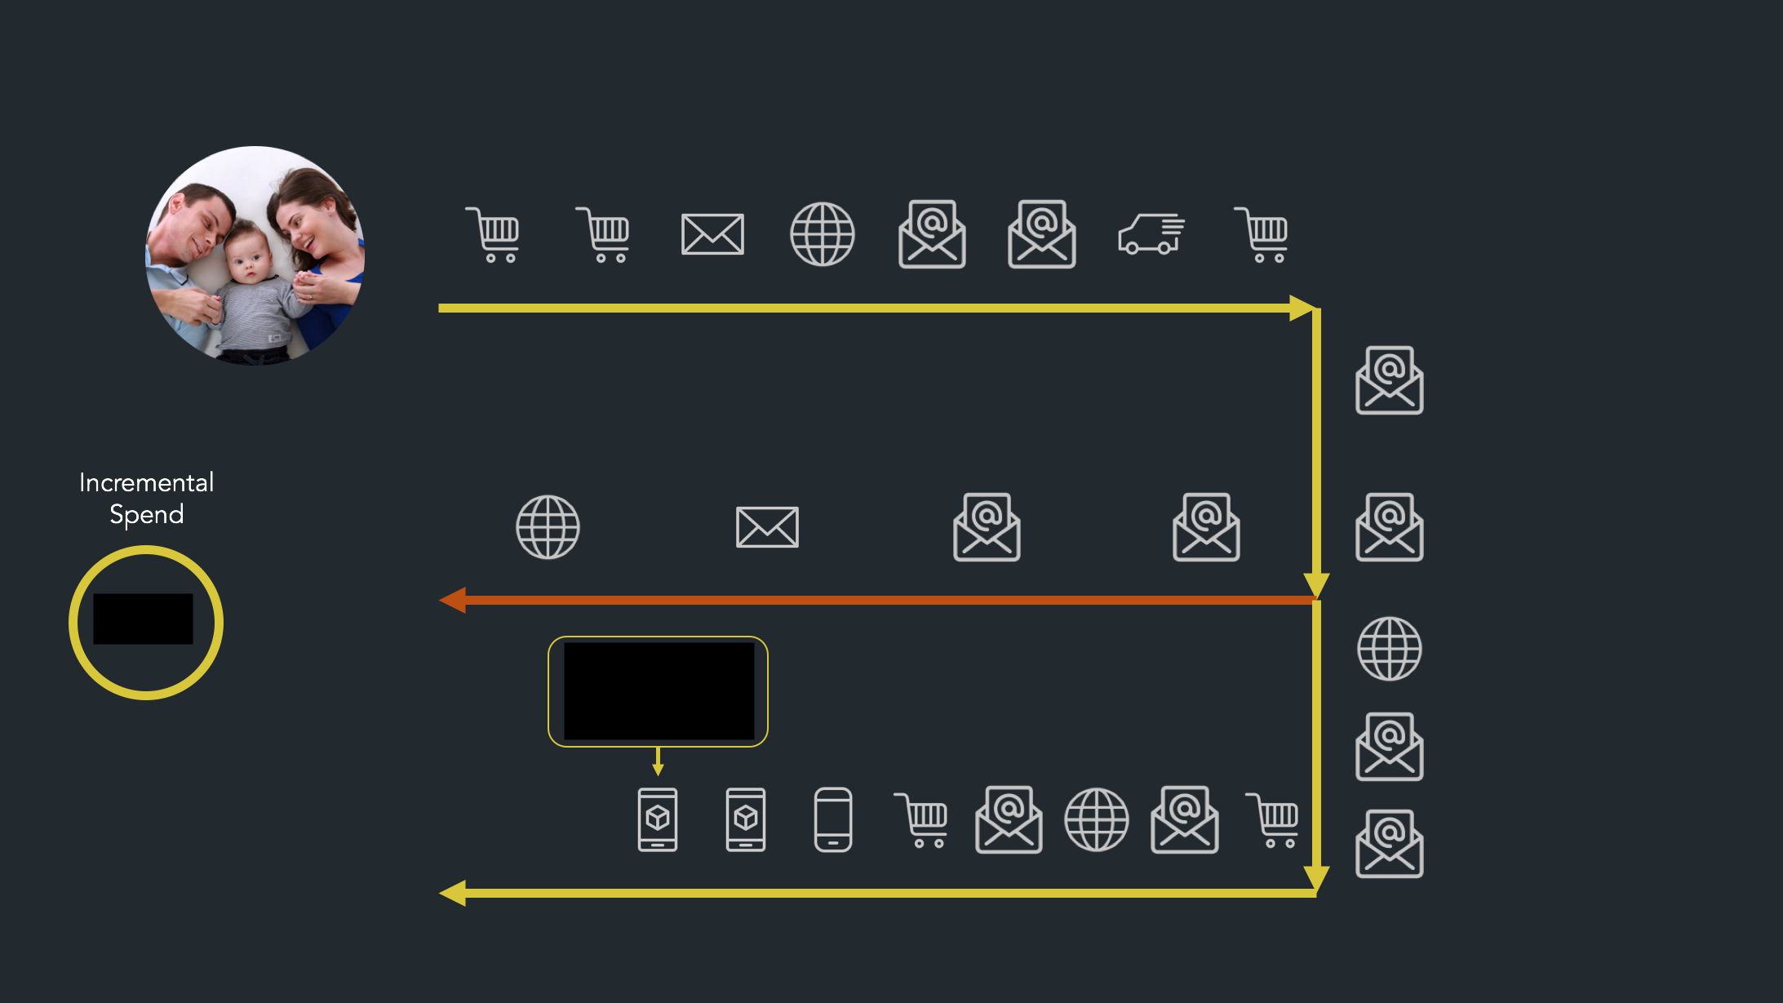

Slide 13
We wanted to use this diagram across many clients, but it took a long time to create each one

Slide 14
So we looked at ways to solve that problem

Slide 15
and discovered a way to solve it using Node.js

Slide 16
You don’t need PowerPoint to create PowerPoint files

Slide 17
You can create them with a text editor

Slide 18
How is this possible?

Slide 19
WHAT IF I TOLD YOU
POWERPOINT FILES
ARE JUST ZIP FILES

Slide 20
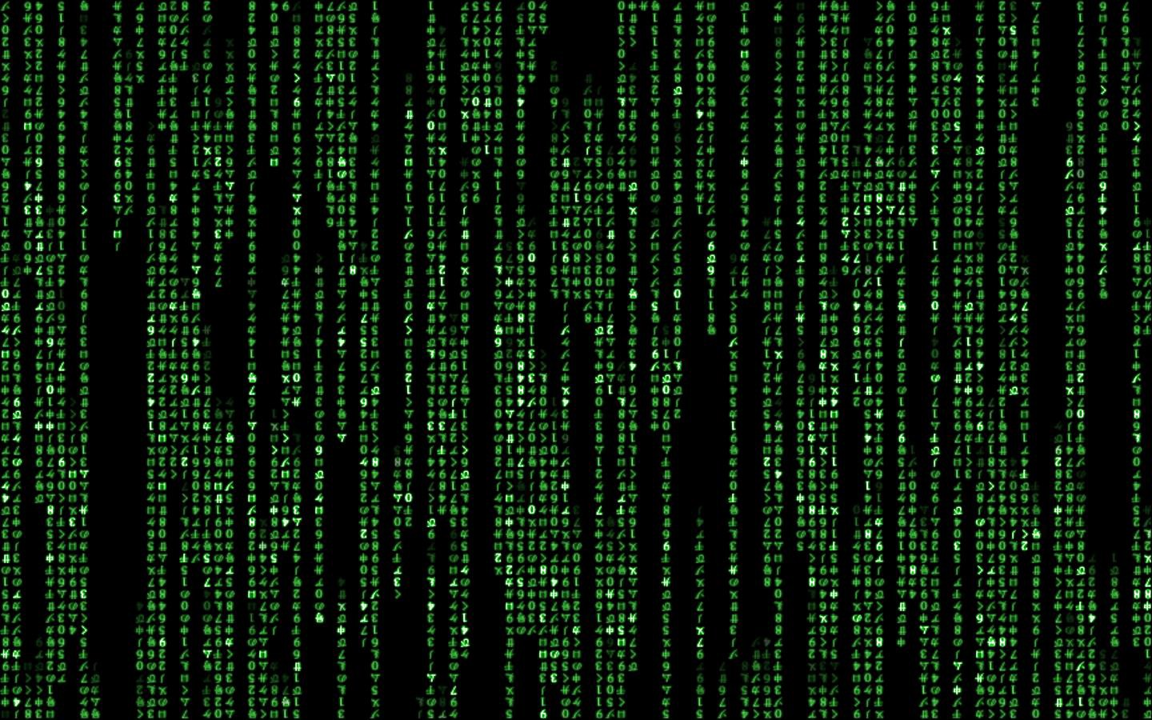
to the terminal

Slide 21
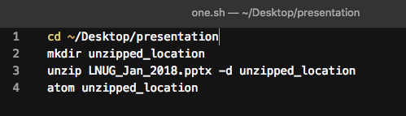

Slide 22
Office Open XML file format

Slide 23
A way to future-proof documents so that they are still readable long after the software that created them is gone*

Slide 24
A way to future-proof documents so that they are still readable long after the software that created them is gone*
* or made illegal by the Anti-PowerPoint Party

Slide 25
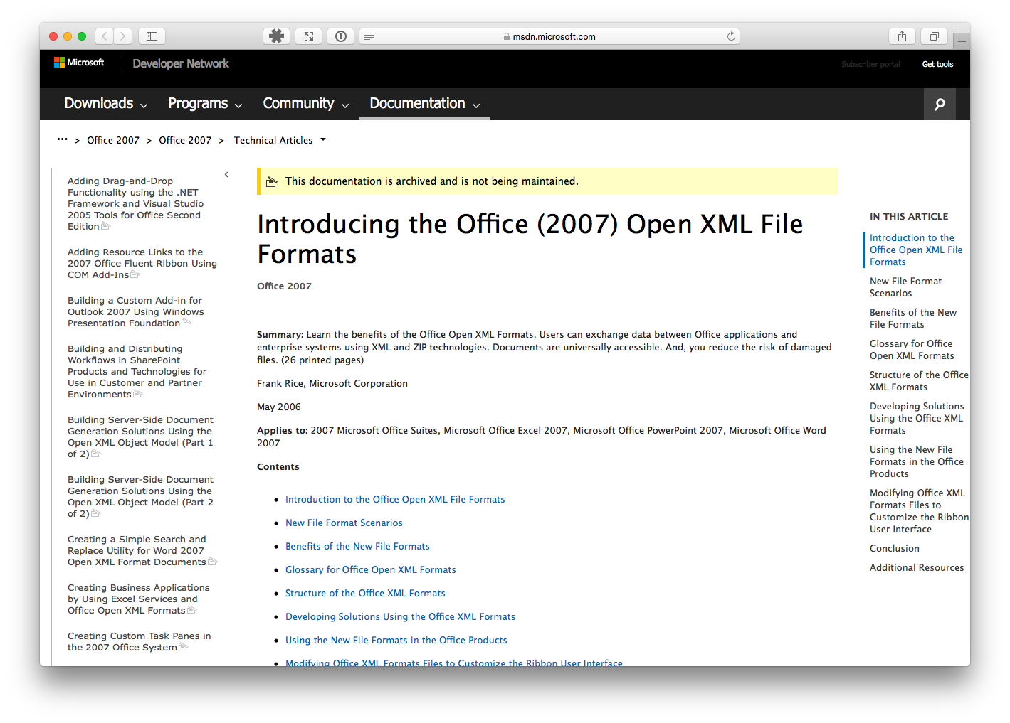
http://bit.ly/1HKT1TH

Slide 26
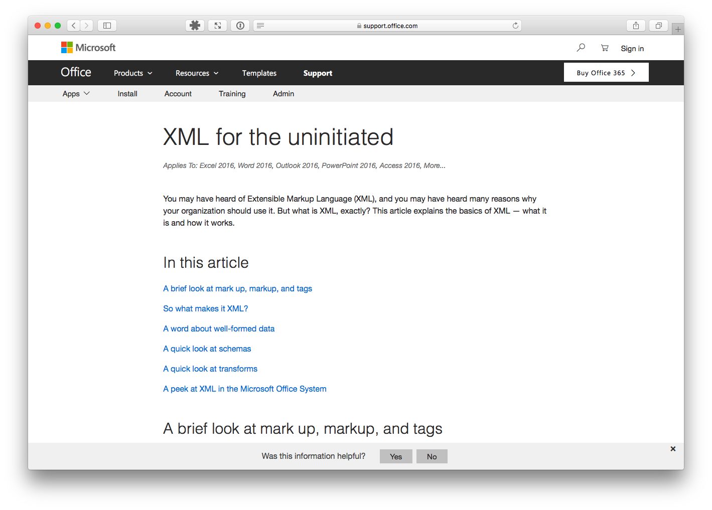
http://bit.ly/2DzQFuK

Slide 27
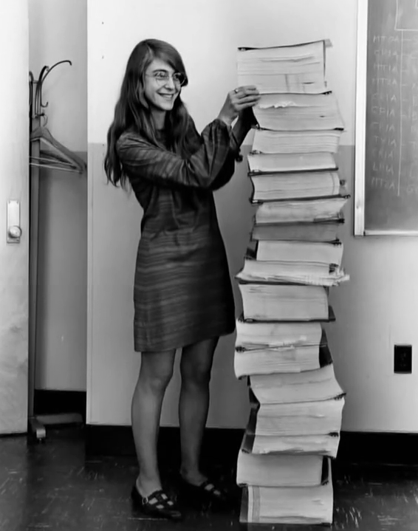
You don’t have to write XML by hand to make these PowerPoint files

Slide 28
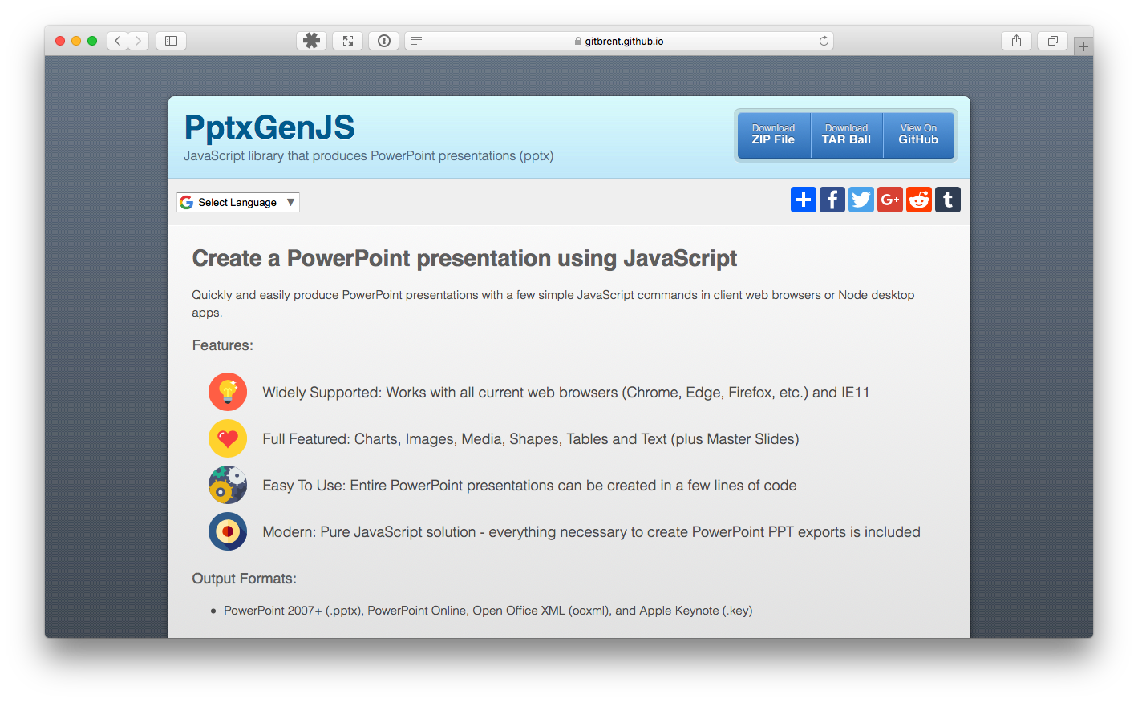
PptxGenJS
https://gitbrent.github.io/PptxGenJS/

Slide 29
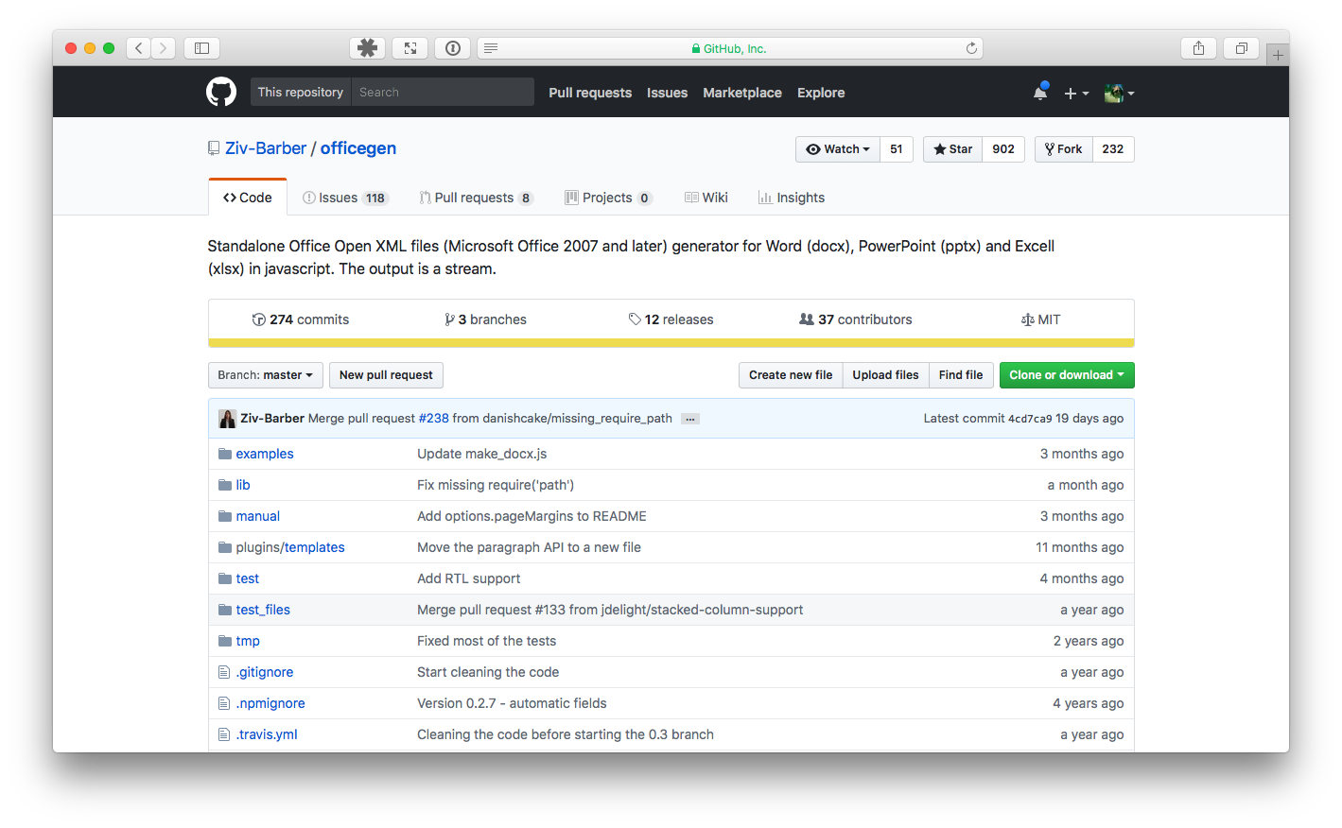
Officegen
https://github.com/Ziv-Barber/officegen

Slide 30
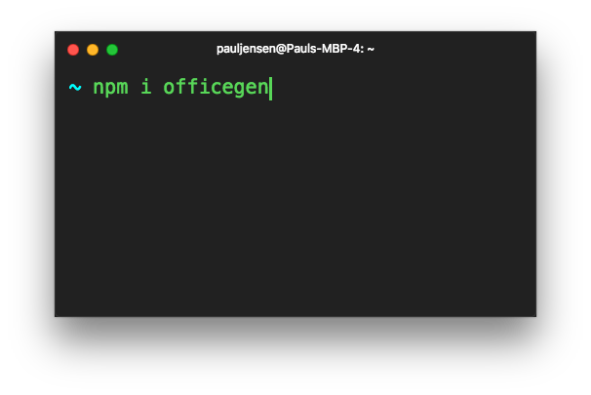

Slide 31
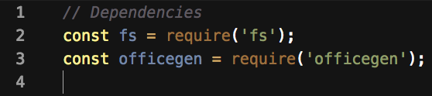

Slide 32
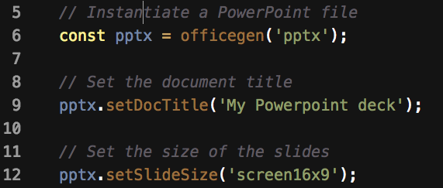

Slide 33
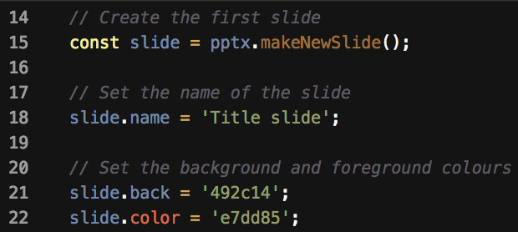

Slide 34
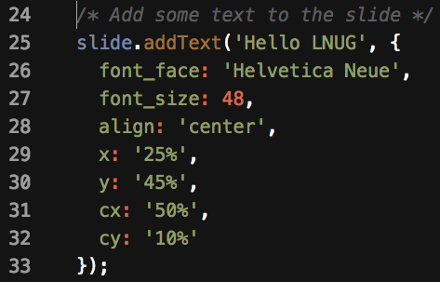

Slide 35
You can also add
Images
Shapes
Tables
Charts

Slide 36
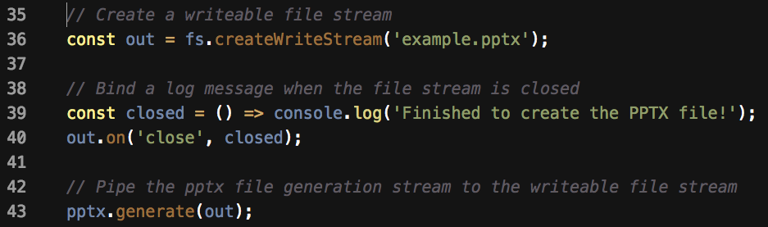

Slide 37
to the code

Slide 38
We used Officegen to automate generating the diagram for us

Slide 39
to the code

Slide 40
So you can create PowerPoint files without using PowerPoint.
Mission Accomplished

Slide 41
Officegen
https://github.com/Ziv-Barber/officegen

Slide 42
PptxGenJS
https://gitbrent.github.io/PptxGenJS/

Slide 43
and if you’re curious…

Slide 44
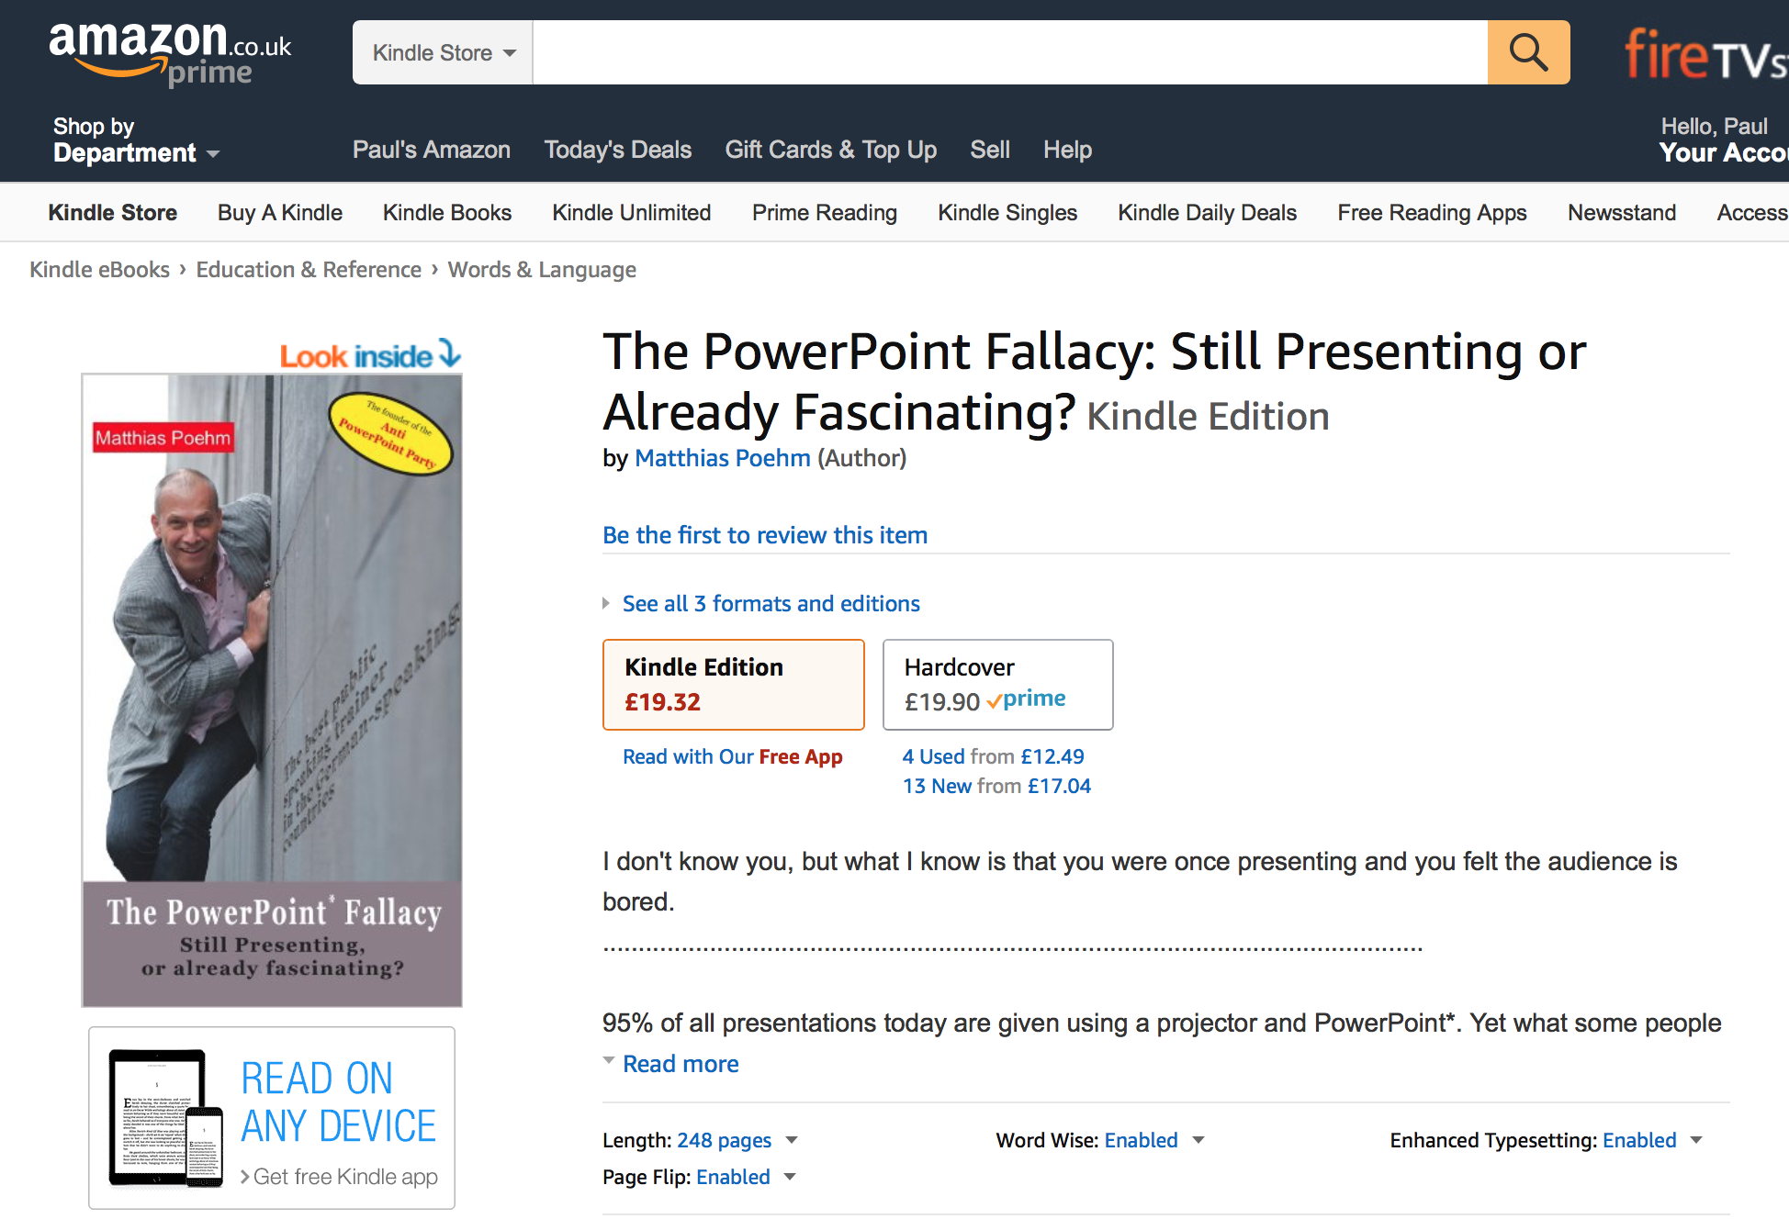

Slide 45
Thank you

